Slide 1
Eventify.co.in
BY :
K. saketh kumar 160121737316
B. prashanth reddy 160121737318

Slide 2
Contents
Abstract
Introduction
Problem statement
Literature review
System requirements
Database design
Objectives
Methodology
Modules
Future works
conclusion

Slide 3
Abstract
Eventify.co.in is a project that brings different event management from different areas coming to single platform so that users can choose a own interest and budget and there requirements. This project aims to simplify handling event management collabroations by providing a web interface for admin and user. This project is built in HTML, JS and CSS as frontend and MySQL as backend We will be showing different things like decorations,music systems , events, food , hospitality of different event management. Users can customize and sort the company according to their need. For example, if a common man wants to do a wedding , he can go through our website and he can select his needs and event management platform. The platform is grand events and normal events.

Slide 4
Introduction
This project brings all the event management organizations and companies together into a single marketplace. This project is named as Eventify.co.in is a Web application which helps the customers and sellers to improve their business and users can utilize the application. This project lets all the users to easily access the different event managing companies .

Slide 5
Problem statement
From the previous slide we can see that we had event management systems for handling tasks for the organizers. But the problem is we can make a updated version of this system in this modern world like the users
Can select the event management company they want from the website and sort the services and prices they need like the swiggy all the restaurants have restaurant management systems but after the swiggy users can order food from their favourite restaurants. Same without project we should give access to the users to customize their needs.

Slide 6
Literature review
Event management systems evolved as a project management systems where it used to handle the the projects in earlier days. Event management systems are used for different events like sport events,weddings,and many more events where the application made the companies easier to handle the events with all the features it provided like handling multiple tasks and scheduling things where the organizer’s Work was made simple.

Slide 7
Contd.
Project name | Date | Author | advantages | Disadvantages
Event management | 2013 | J peter | Managing different events | Standalone applications
Online event management system | Sept,2018 | Nuwagaba andrew | Online system | No flexibility

Slide 8
System requirements
Software requirements :
FRONTEND: HTML and CSS, JavaScript ; BACKEND: PHP
Visual Studio code editor to execute the entire code,xampp server
Hardware Requirements
Recommended operating system:Windows
Processor: Minimum 1 GHz;
Recommended 4 GHz or more.
RAM: Minimum 512 MB,Recommended 4 GB or more
Graphics card: Integrated Graphics

Slide 9
Database design
Database name : batch_8
Tables : user credentials
Database used : mysql connected through phpmyadmin

Slide 10
Objectives
To provide interfaces for both user and organizer.
The users application should have all features to give orders
Host website should have all the users details and also
Primary objective is host website should have the event management feature where they can handle tasks
Bringing all these features into single marketplace

Slide 11
Methodology
The users website : This site has all the listings of all the companies that provide the services and users can also choose what service they need And they can place order and contact the companies and also they can finalize the summary.
The host website : This has two parts first one is where they receive the users input according to which they need to render their services and with all the inputs they have it will automatically make an event management system inbuilt so that onsite they can handle tasks easily without going through the details again

Slide 12
Module 1
Based on the study of the IEEE papers and literature review we can say that in the year event management systems emerged and they used it to manage events through a web based application like budgeting, scheduling, orders etc that is fine upto the organisers point of view and there was no use of the data of the events conducted by the companies it was a simple gui based web application where they just manages tasks.

Slide 13
Module 2
With the years passing updated versions of the management systems came but there was no proper integration , data didn’t play a major role users cannot see the progress of their event and they just need to rely on the organizers so what makes our application unique from the above two modules is that the users get to have all the details of the event and they can even choose the companies.

Slide 14

results

Slide 15
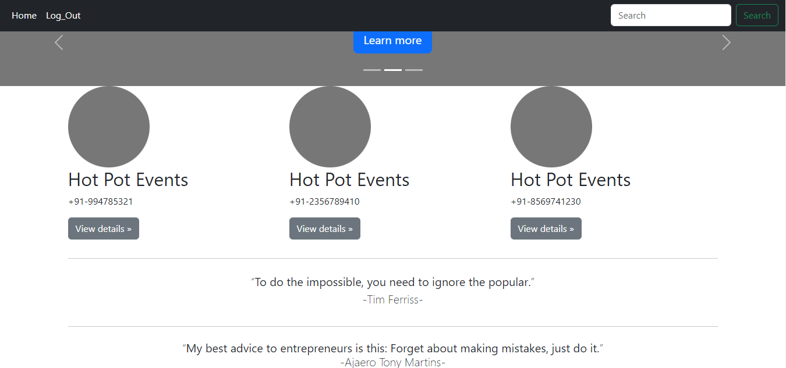
Result

Slide 16
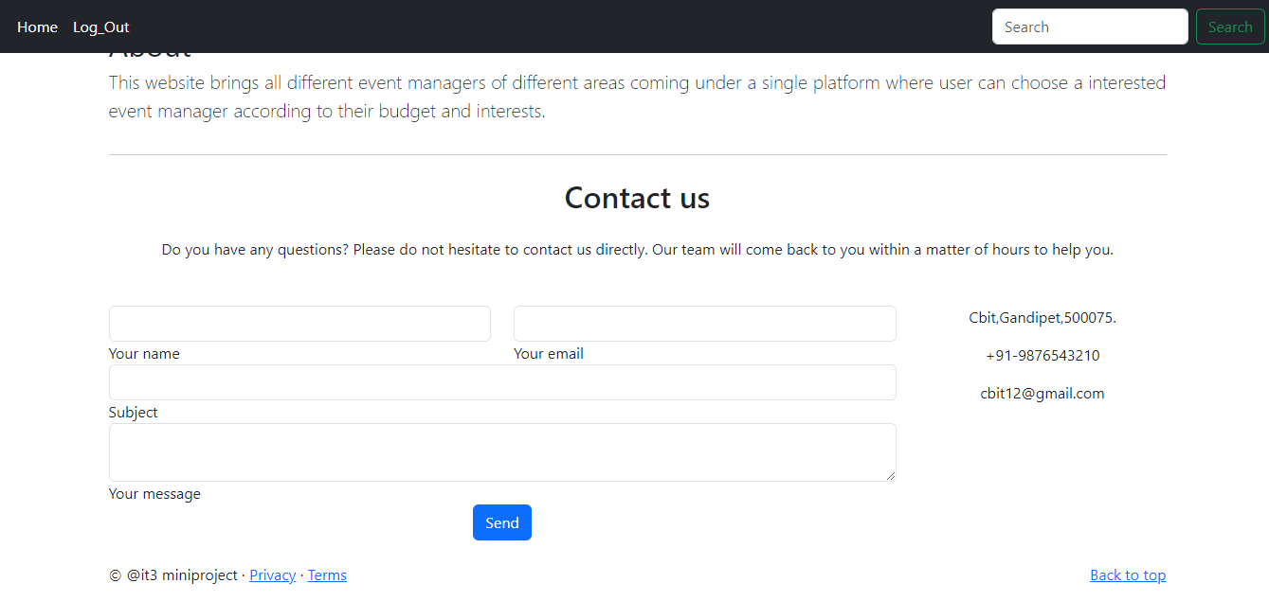

Slide 17
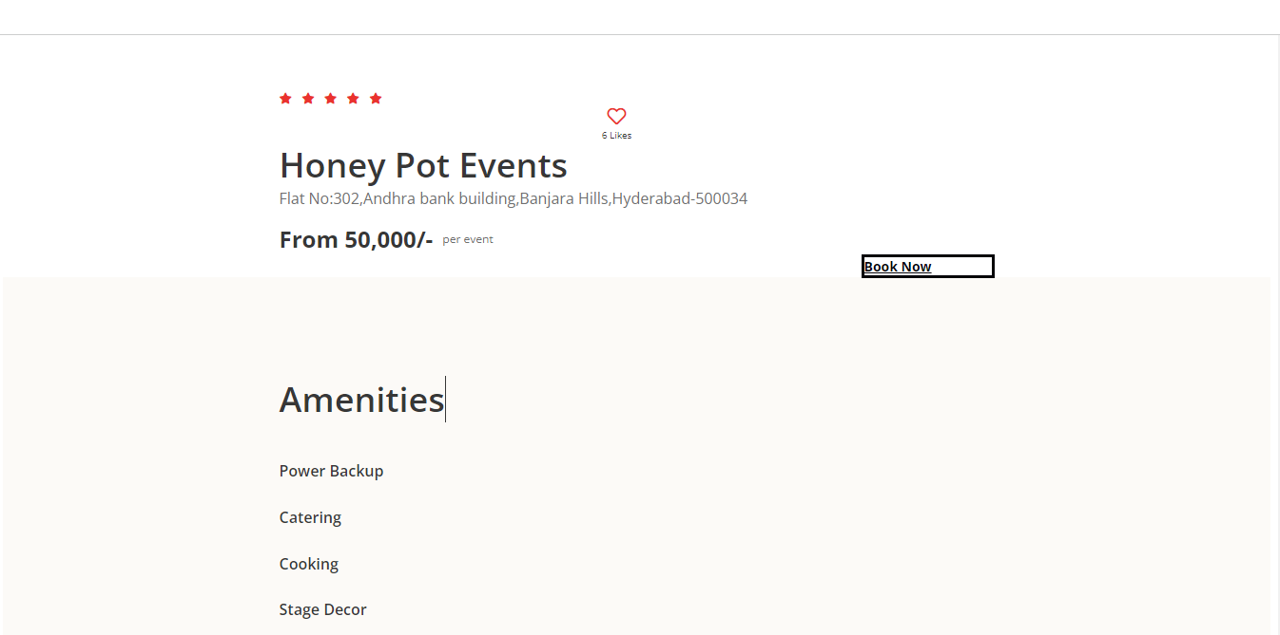

Slide 18
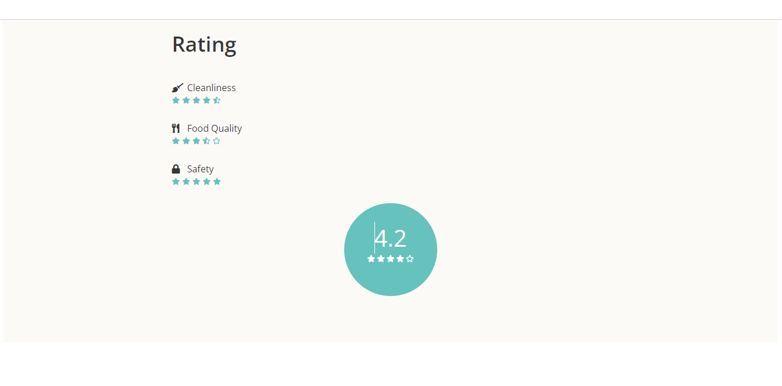

Slide 19
Future works
This platform will be made in 2 interfaces , one is admin and another for user. Admins can login in and register event management systems , the user can through different events and packages. This is a simple web interface and also host website has the natural event management system to control events.

Slide 20
Conclusion
This project when implemented correctly can generate revenue and also make a good profitable business and this solves a problem because the users have all the companies in a single place without any tensions all the aspects of event management things are done here from A to Z from providing services to handling events this is best place for people to come together and Also new entries to event management field can have their market with this platform and the data plays a major role as we are integrating both the booking system and the management system we can use the data.

